Slide 1

Hire the best talent from campus
Digitally. Scalably. Securely.
Introducing Mercer | Mettl’s all-in-one
Platform for Virtual Campus Hiring
Sept 2021
Copyright 2020 Mercer LLC. All rights reserved.

Slide 2
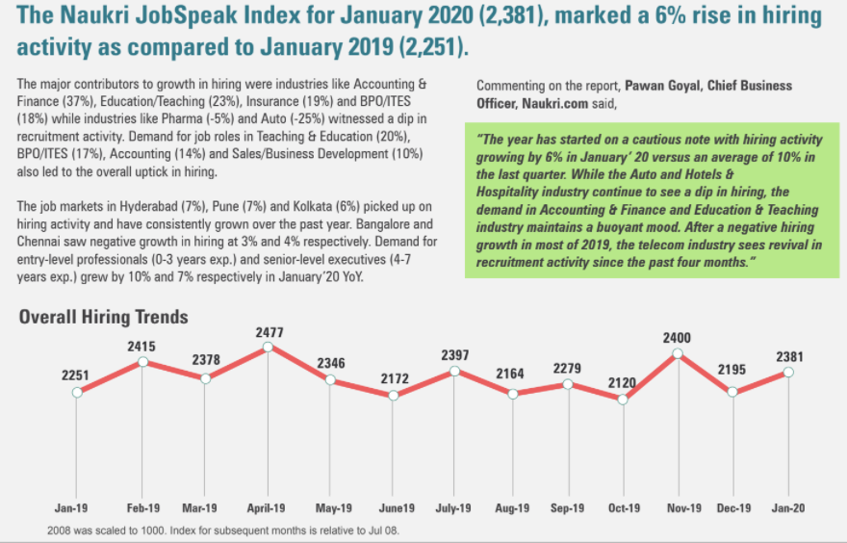
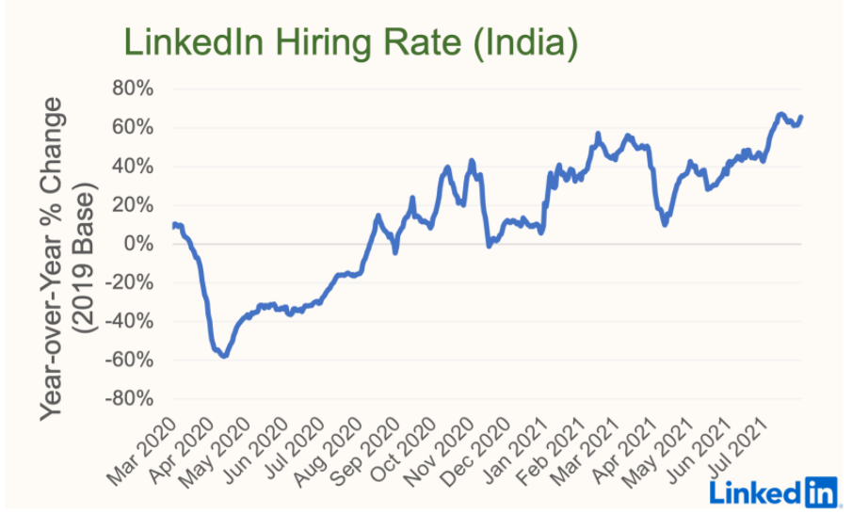
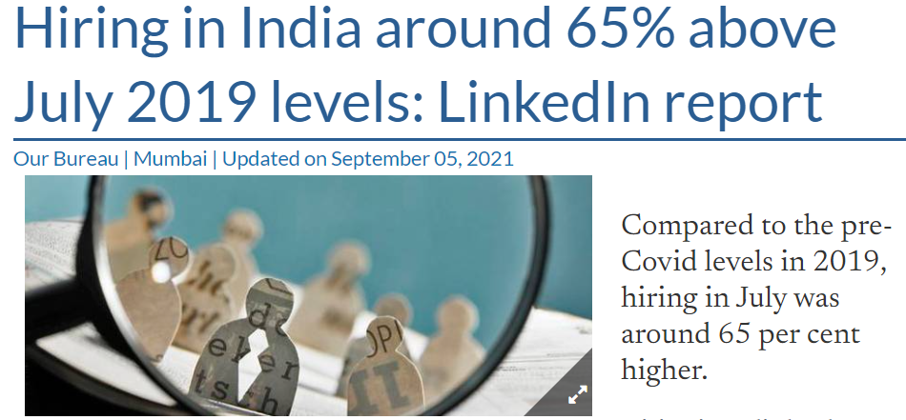
Talent landscape in India since 2019
2019
March 2020
March 2021
2021
Talent War in Indian market
Pre-covid
Phase-1
Phase-2

Slide 3
The reality of today
CEO’s #1 Challenge Today is Finding the Right Talent
- Annual CEO Benchmarking Report
Problems we often hear from our clients:
Our biggest challenge currently is managing attrition at entry level which has massively increased our hiring costs.
Campus hiring is a tedious and time-consuming process while ensuring skilled freshers are hired from the colleges.
Differentiating between average and good has been the toughest challenge for us to ensure a strong workforce.
HIRING MANAGER
(One of the top FMCG Firms)
TALENT ACQUISITION HEAD
(One of the top Telecom Firms)
HIRING MANAGER
(One of the top IT Firms)

Slide 4




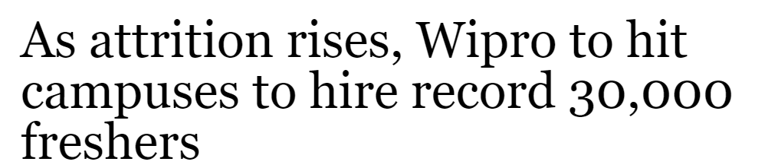
Talent Demand – Supply gap
Most organizations heading to ‘crowded’ campuses
Demand
Supply
Employee exits could well impact their double-digit growth plans. Going by the commentary the top three IT services will
hire over 75,000 campus freshers for FY22
800+
universities
8.5Mn+
grads and post grads (2021)
40,000+
campuses
46%
grads employable (2021)
Campuses are divided into Tiered Structure with across the geographical breadth of the country.
Within campus recruitment also, there is a talent war for the right talent.

Slide 5
Traditional Campus Recruitment Process
1
Connect
2
3
Select
4
Assess
Engage
Pre-placement presentation
Written Examination
Technical Interview
Post placement Engagement
Resume shortlisting
Group Discussion
Formal Interview
Offers made to be best talent in-person.
What was the biggest challenge with your company’s traditional campus recruitment process?
32%
Resource intensive (Time, Money, People)
41%
Lack of predictive analytics
27%
Others (Diversity, Bias, Candidate experience)
Source: Talent Assessment Practices Survey, Mercer | Mettl 2020

Slide 6
Virtual Campus Process
1
Connect
2
3
Select
4
Assess
Engage
Campus shortlisting and selection
Virtual candidate screening
Virtual structured & coding interviews
Virtual campus engagement and innovative hiring
using
using
using
using
Mercer | Mettl’s campus intelligence and management solution
Mercer | Mettl’s powerful proctoring technology and holistic assessments
Mercer | Mettl’s video interview platform
Mercer | Mettl’s online Hackathons and Ideathons platform

Slide 7

Virtual Hiring Strategy is the need of the hour for agile, modern organizations
79%
Moved to virtual Hiring in 2020-21
21%
Postponed hiring plans, froze hiring efforts, focused on internal movement in the meantime
Benefits of a virtual process:
Challenges of a virtual process:
Lesser resources – Cost and time
Identify best talent through data
Immune to disruptions such as Covid-19
Removes hiring bias
Entire change management
Questioned the efficiency
Source: Talent Assessment Practices Survey, Mercer | Mettl 2020-21

Slide 8



What differentiates us ?
Reach
User experience
4 Lakh+ Student
relationships
Modern and dynamic platform that is built for the future.
It is seamless to use for the candidates and offers new age assessment tools like coding simulators
Scale
Customizability
2000+
Campus partnership
2.5 crore+ annual
assessments
The platform is easy to customize, according to the requirements of industries, roles, etc.
It is built in India but for the world with support for 26+ languages across 80+ countries
Achieved
200,000 assessments
in a day

Slide 9
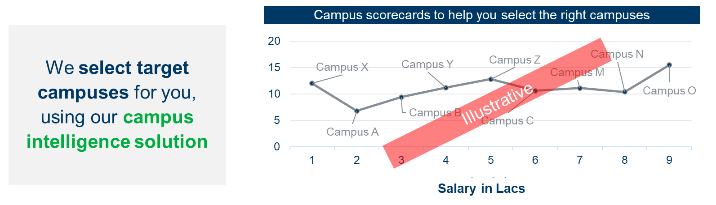
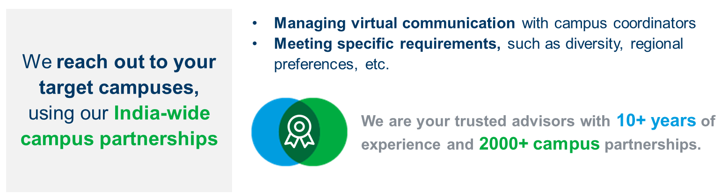
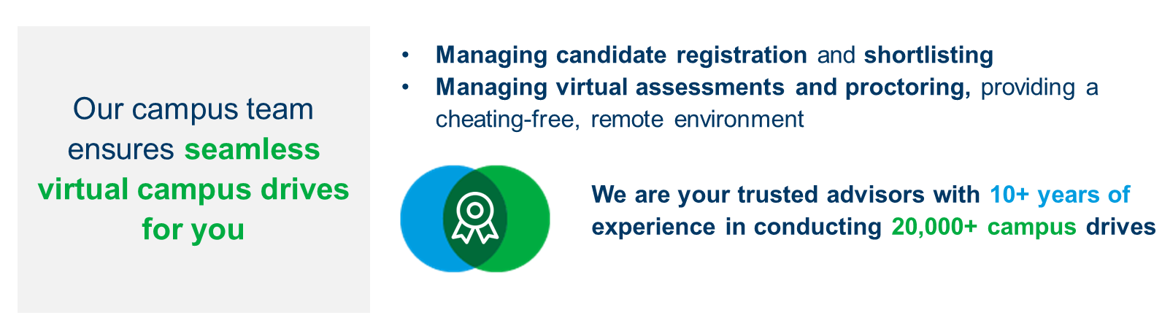
Campus select
Connect
Candidate Support
Campus Connect

Slide 10

Assess
Coding assessments
Aptitude and coding tests | Extensive coding simulators
Measure coding aptitude and real-life programming skills
Technical assessments
Domain tests for 100+ skills and job profiles
Measure domain skills and technical aptitude
Save hiring cost
Customize as per requirements
Identify best fit
candidate in the
least time
Psychometric and behavioral assessments
Aptitude tests
Measure reasoning and logical
thinking skills
Personality & behavioral tests
Predict cultural fitment and behavioral traits
at workplace
Communication skills assessments
English Language Based Communications Skills Tests
Assessments to measure Speaking skills, Listening skills, Reading skills & Writing skills

Slide 11
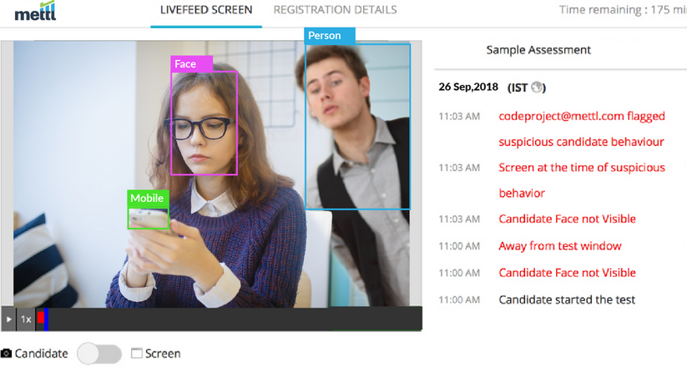
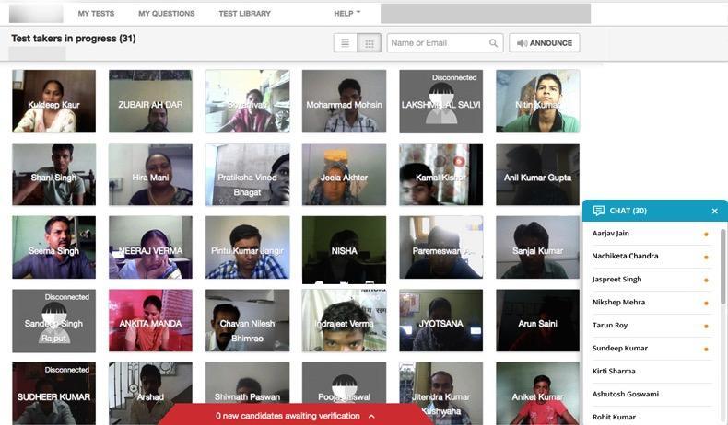
Our industry-leading proctoring technology
ensures cheating-free assessments from the comfort of candidates’ homes
AI-based auto proctoring
Credibility Index to make quick decisions
Face/device/people and several other cheating flags
Secure browser and detect distraction levels
Human-assisted live proctoring
Proctors can broadcast to all test-takers
Live webcam/ screen feed of candidates taking
the test.
Chat with candidates to assuage concerns
Please visit https://mettl.com/online-remote-proctoring?utm_medium=website&utm_source=direct for more information.

Slide 12
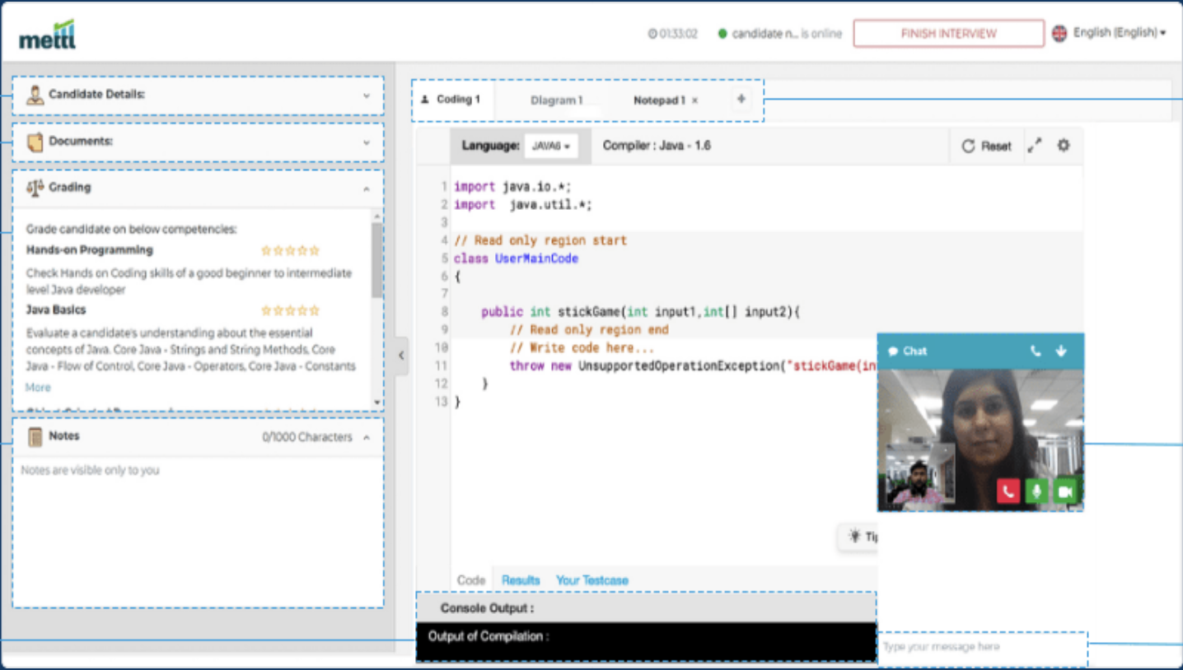
Select
Pair programming interview
Evaluate real-time coding skills as the candidate codes live on screen
Quick, objective evaluation
Evaluate data from screening and interview rounds within one single platform
Digital ideation
Whiteboard and ideate digitally, using digital whiteboards and notepads
Please visit https://mettl.com/virtual-video-interview-platform/ for more information.

Slide 13

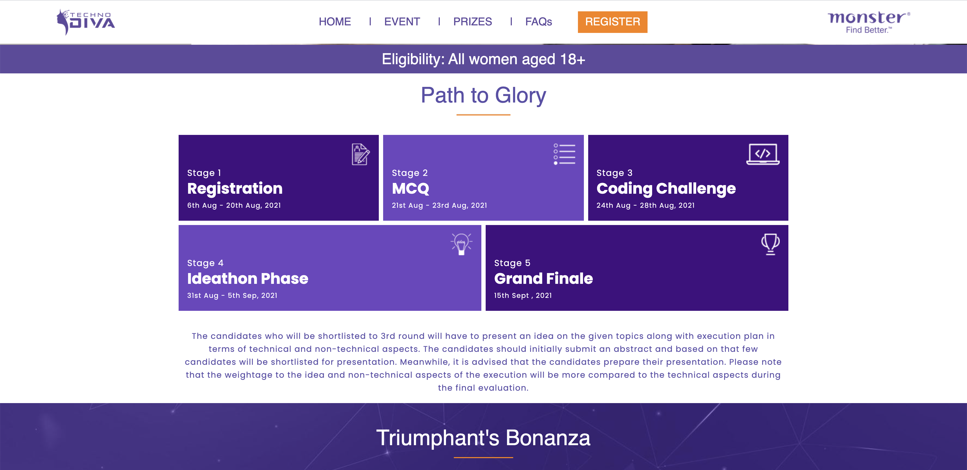

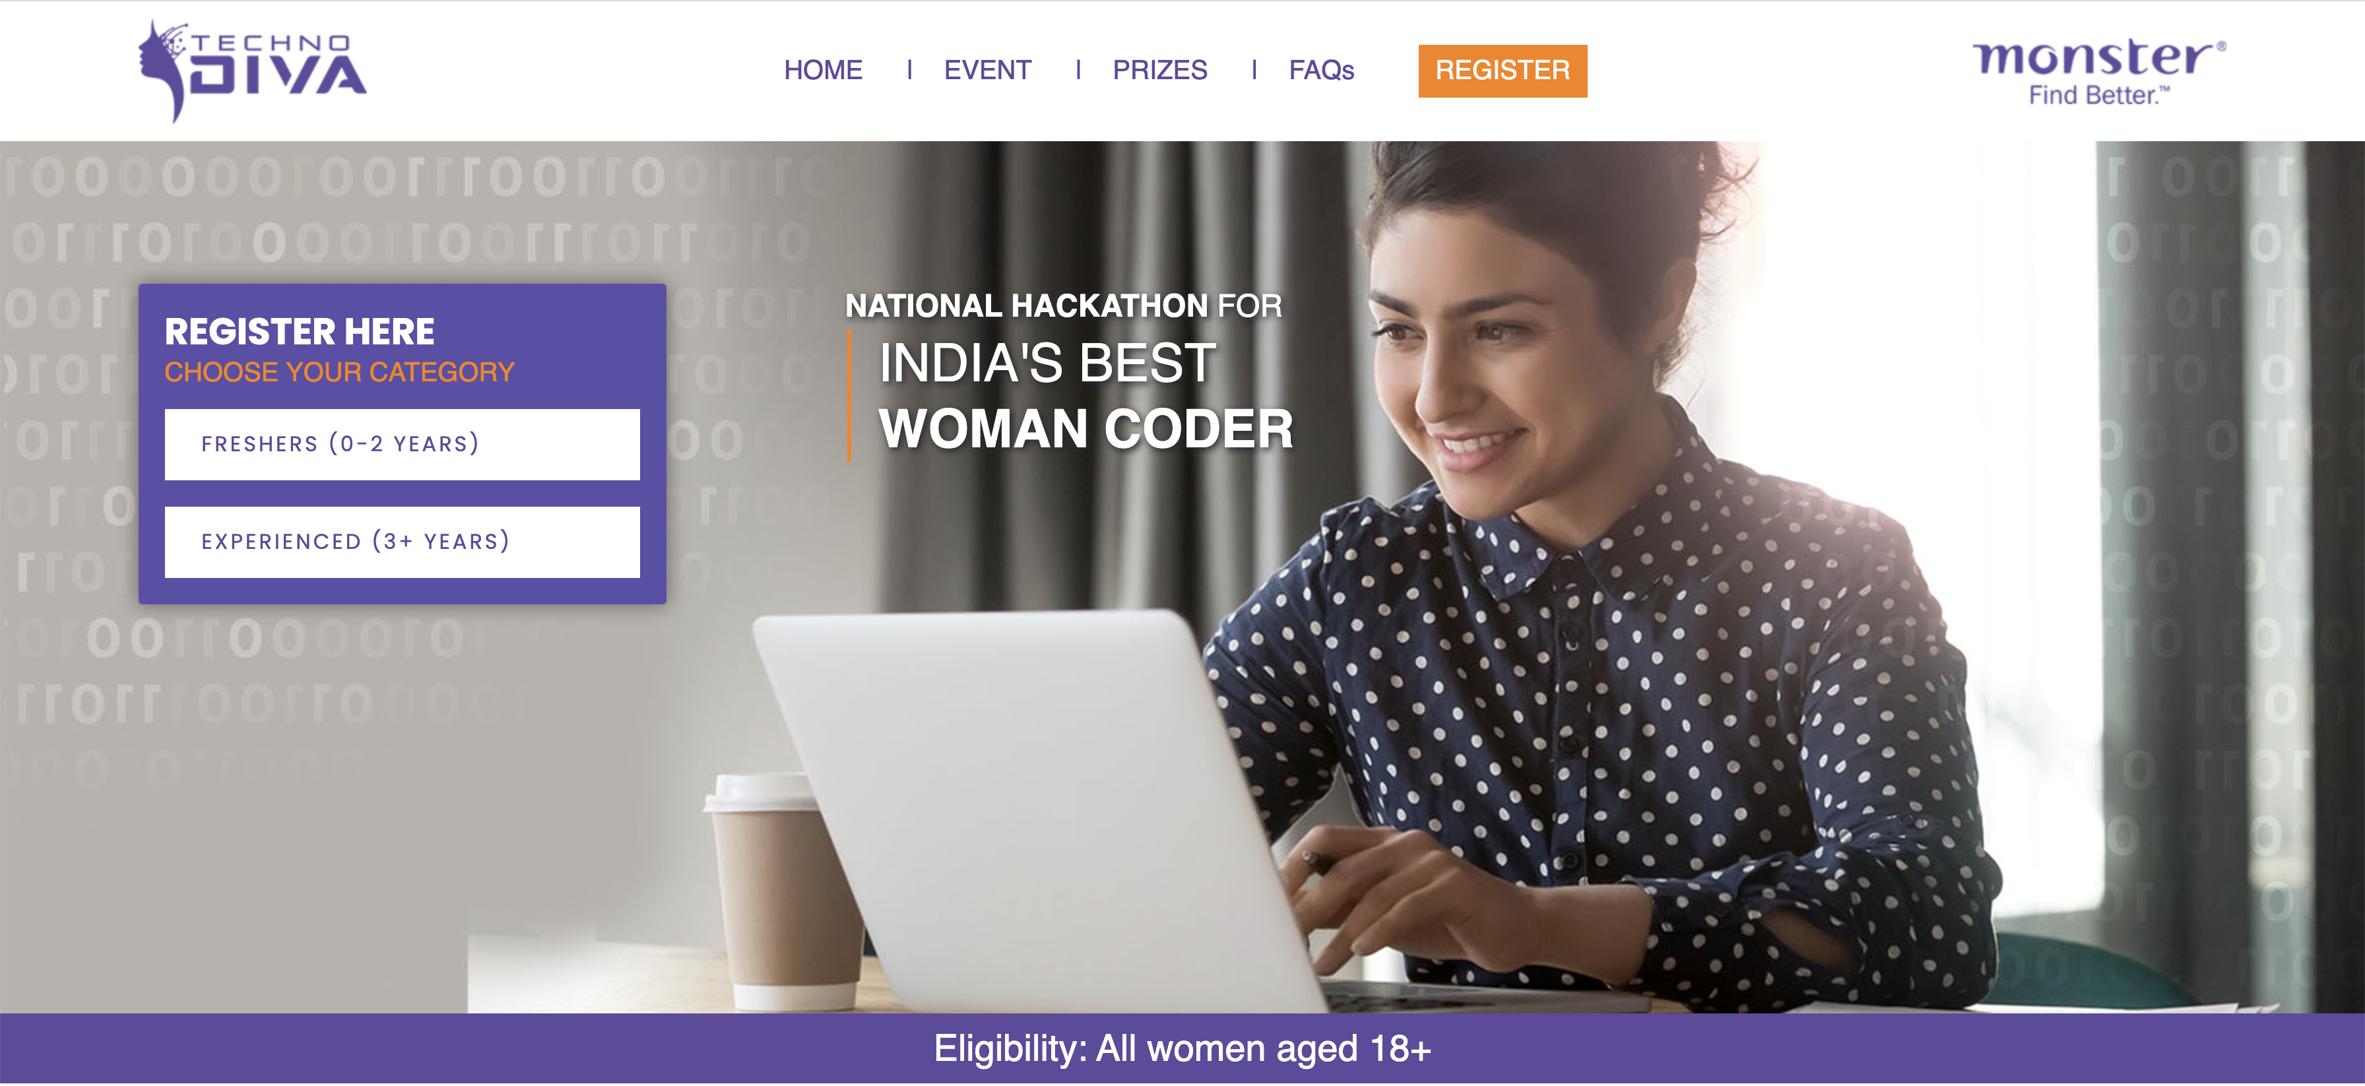



Engage
Virtual conferences
Virtual Job fairs
Virtual onboarding
sessions
Virtual engagement
events
Virtual hackathons
& ideathons
Please visit https://mettl.com/virtual-video-interview-platform/ for more information.

Slide 14
Case Study
E-school, B-school, Diversity hiring, Hackathon
Genpact
Amazon
Accenture
CGI
Tata Elxi
Measure English communication as part
of the Campus process
Benchmarked to
CEFR standards
28 campuses, 20 states
22,000 assessments done
One assessment for multiple job role evaluation – Technical, Aptitude and Coding
Non SDE roles (QA, Software Tester,
DB Admin)
80 Campuses, Tier 1, Tier 2 – 15000 assessments
WOW Diversity Hackathon –
SDE/non-SDE
23000 assessments,
35K registrations,
200+ campuses
B-School – Consulting,
HR and Digital
(top 10 B school)
Case-study simulator
Tech + Consulting roles from B Schools (Engineering background to be hired as consultants for AI,ML etc.)
4000 candidates to be hired, 35K assessments planned
Domain/Tech/Aptitude assessments from Mettl
Tech – Java/SQL roles, engineering roles
Hackathon to hire candidates
End to end process is driven by Mettl
Reach out to 8K candidates (West and South) for 120 hires
Tech Aptitude and Coding Question types
Augmenting R&D unit in Bangalore
Tech Assessment and Simulator to hire for multiple
job roles
Proctored on Mettl Secure Browser
and AI
600 hires, 25000 assessments in
250+ campuses
(Tier 1 and tier 2)

Slide 15

Our integrated platform empowers organizations to have end-to-end virtual hiring drives
All-in-one platform to assess
and interview
Seamless to integrate onto ATS
and HRMSs
In-depth data analytics and
automated reports
Best-in-class security features
We are your trusted campus hiring advisors with 10+ years
of experience in conducting 20,000+ campus drives
across India

Slide 16








Our enhanced security features ensure your data & information is kept safely
  IS0 27001 Certified
  IS0 9001 Certified
  GDPR
  Compliance
  Innovation
  Partner
Data encryption in transit and at rest
Multi-Factor Authentication (MFA) enabled
Defined access rights, log reports and audit trail
Annual Vulnerability & Penetration Testing
Frequent internal & external audits
Access all this data anytime, anywhere
Student
Personal Data
Exam
Results
Question Banks

