Slide 1
How to assess the communication skills of your candidates at scale
Live Demo
August 2021
Copyright 2020 Mercer LLC. All rights reserved.

Slide 2
Our Experts
Anirban Roy
Sharad Sharma
Chief Revenue Officer,
Mercer | Mettl
Chief Product Officer,
Mercer | Mettl
Subhro Bera
Kaustubh Bansal
VP, Psychometric Assessments Data Analytics, Mercer | Mettl
AVP, Product,
Mercer | Mettl

Slide 3
Key drivers of “communication” as an essential skill
Remote Work
Future of Work and Skills
Mastery required vs. Time to Skill

Slide 4
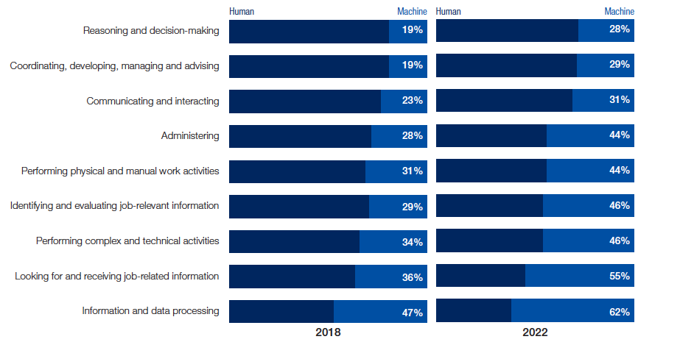
Communication – In context of future of work
Top 3 missing soft skills
Problem solving thinking, innovation & creativity
Ratio of Man-Machine working hours 2018 vs 2022 (projected)
Ability to deal with complexity and ambiguity
Communication
Source: Future of Jobs Survey 2018, World Economic Forum
Source: SHRM – “The Global Skills Shortage”

Slide 5
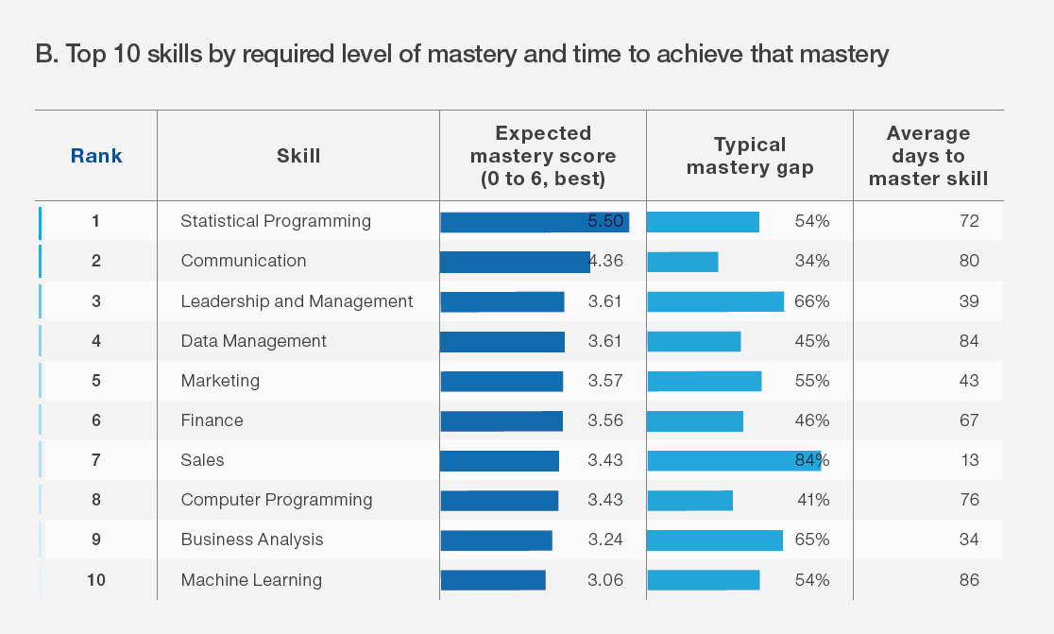
High expected mastery but with high upskilling time
Source: Future of Jobs 2020 – World Economic Forum

Slide 6
Key problem statement
How can you effectively measure “Communication” especially at a pre-hire stage?
Nuances in Communication as a Skill
Measuring different aspects of Communication
English Communication - Spoken English
Workplace communication vs. language ability
Establishing reliability and validity
Customization vs Standardization

Slide 7
Live Demo

Slide 8
Determine spoken english skills of a non-native speaker
An Auto-Graded Tool to judge the Ability of a candidate to Speak English and Understand Spoken English
Human & AI Intelligence
Actionable Reports
Powerful Technology Blended with Subject Matter Expertise
Objective & Insightful Reports Generated in Real-Time
Candidate & Recruiter Friendly
Cheat-Proof
No Administrative Challenges - Save Effort and Time
Ensure Test Integrity and
Make Process Auditable

Slide 9
Reliable multi-layered technology
Patented technology
CarnegieSpeech’s patented Pinpointing Technology and Speech Recognition Engine is combined with proprietary voice analytics
2 key dimensions
Linguistic
Identify exactly what was correct and incorrect in the candidate’s speech
Flexible engine
Para-Linguistic
Measure Quality & Clarity of candidate’s speech
Accommodates each user’s native language and nuances like - gender, cultural context and geography

Slide 10
SpeechX - Assessment
Content
SME Authored
Based on CEFR guidelines
Average Test Duration ~30 Minutes
Content and Grading Methodology aligned to needs & best practices
Insights captured from multiple industry practitioner, VNA trainers and SME’s
Multiple Question Types
Read/ Listen and Repeat, Free Speech, MCQ , FIB etc.
Scoring parameters
Overall SpeechX Score and 4 Sub-Scores
Pronunciation*
Fluency
Grammar*
Listening Comprehension
CEFR Ratings available

Slide 11
Key evaluation parameters
Check for 8+ High Impact Non-trainable sounds – e.g. Consonant Swap, Vowel swaps e.g. (sheet – seat), (this – dis), apologize (z-j)
Pronunciation
Check for High Impact (e.g. SVA) and Low Impact (Prepositions etc) Grammatical errors
Grammar
Fluency
Measured across 10+ dimensions – Speaking Rate, Pausing etc.
Listening
“Story” based questions
Check for Fact based and inference-based understanding
Product builds in the nuances of VNA trainer evaluation

Slide 12
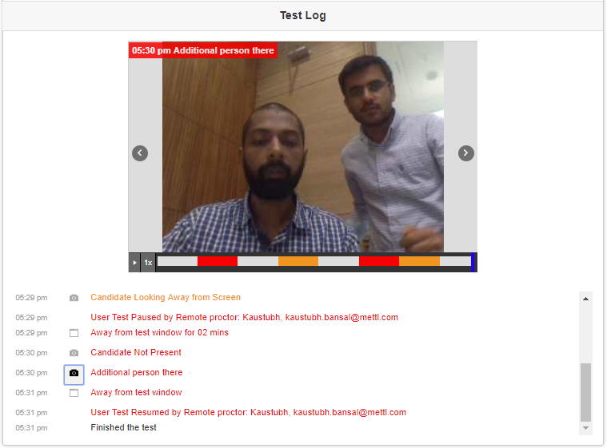
Anti-cheating measures
Candidate Authentication
Proctoring
AI flags
Reports with Candidate and Screen Snapshots
Customizable registration fields
Test-taker image taken
ID image Taken
Facial detection
Device detection
Body detection
Video Feed
Violations
Audio Feed
Credibility Index
Screen Feed
Online assessment
AI-based proctoring
Student’s report with Credibility Index

Slide 13
Speech X – Key differentiators
Evaluation methodology
Incorporates CEFR guidelines
Checking for High-Impact errors which make a candidate non-trainable
Reliable technology
Patented & Accurate Speech Technology from Carnegie Speech
Subject Matter Expertise blended with AI Technology
Anti-cheating measures
Auto-generated Cheating flags using AI Proctoring Technology
Image & Audio Capture ensures Process Auditability

